Slide 1
Chapter 10
Risk and Return: Lessons from Market History
McGraw-Hill/Irwin
Copyright © 2010 by the McGraw-Hill Companies, Inc. All rights reserved.

Slide 2
Key Concepts and Skills
Know how to calculate the return on an investment
Know how to calculate the standard deviation of an investment’s returns
Understand the historical returns and risks on various types of investments
Understand the importance of the normal distribution
Understand the difference between arithmetic and geometric average returns

Slide 3
10.1 Returns
Dollar Returns
the sum of the cash received and the change in value of the asset, in dollars.
Dividends
Ending market value-Initial Investment
Time
0
1
Percentage Returns
the sum of the cash received and the change in value of the asset, divided by the initial investment.
Initial investment

Slide 4
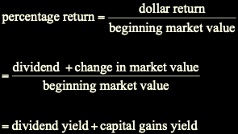
Returns
Dollar Return = Dividend + Change in Market Value

Slide 5
Returns: Example
Suppose you bought 100 shares of Wal-Mart (WMT) one year ago today at $45. Over the last year, you received $27 in dividends (27 cents per share × 100 shares). At the end of the year, the stock sells for $48. How did you do?
You invested $45 × 100 = $4,500. At the end of the year, you have stock worth $4,800 and cash dividends of $27. Your dollar gain was $327 = $27 + ($4,800 – $4,500).
Your percentage gain for the year is:
$327
7.3% =
$4,500
Notes:
It is worth pointing out to students that it does not matter if you sell the shares at $30 or just hold them (ignoring taxes). It’s a good way to reinforce earlier discussions about opportunity cost.

Slide 6
Returns: Example
Dollar Return:
$327 gain
$27
$300
Time
0
1
Percentage Return:
$327
-$4,500
7.3% =
$4,500

Slide 7

10.2 Holding Period Return
The holding period return is the return that an investor would get when holding an investment over a period of T years, when the return during year i is given as R_{i}:

Slide 8
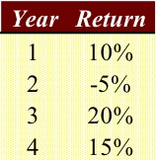
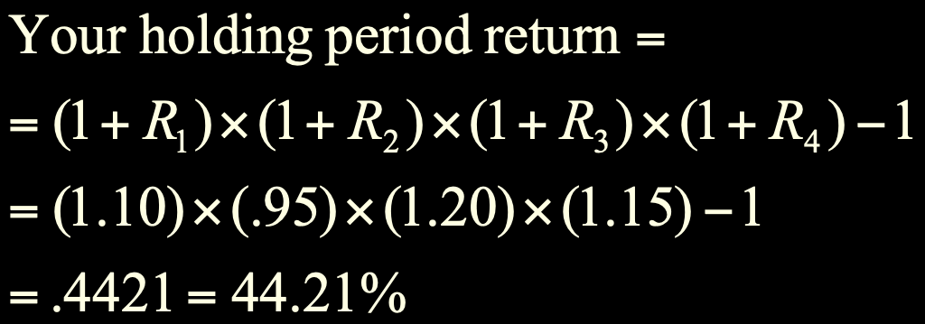
Holding Period Return: Example
Suppose your investment provides the following returns over a four-year period:

Slide 9
Historical Returns
A famous set of studies dealing with rates of returns on common stocks, bonds, and Treasury bills was conducted by Roger Ibbotson and Rex Sinquefield.
They present year-by-year historical rates of return starting in 1926 for the following five important types of financial instruments in the United States:
Large-company Common Stocks
Small-company Common Stocks
Long-term Corporate Bonds
Long-term U.S. Government Bonds
U.S. Treasury Bills
Notes:
A discussion of Figure 10.4 would be helpful at this point, noting the historical relation between risk and return.

Slide 10
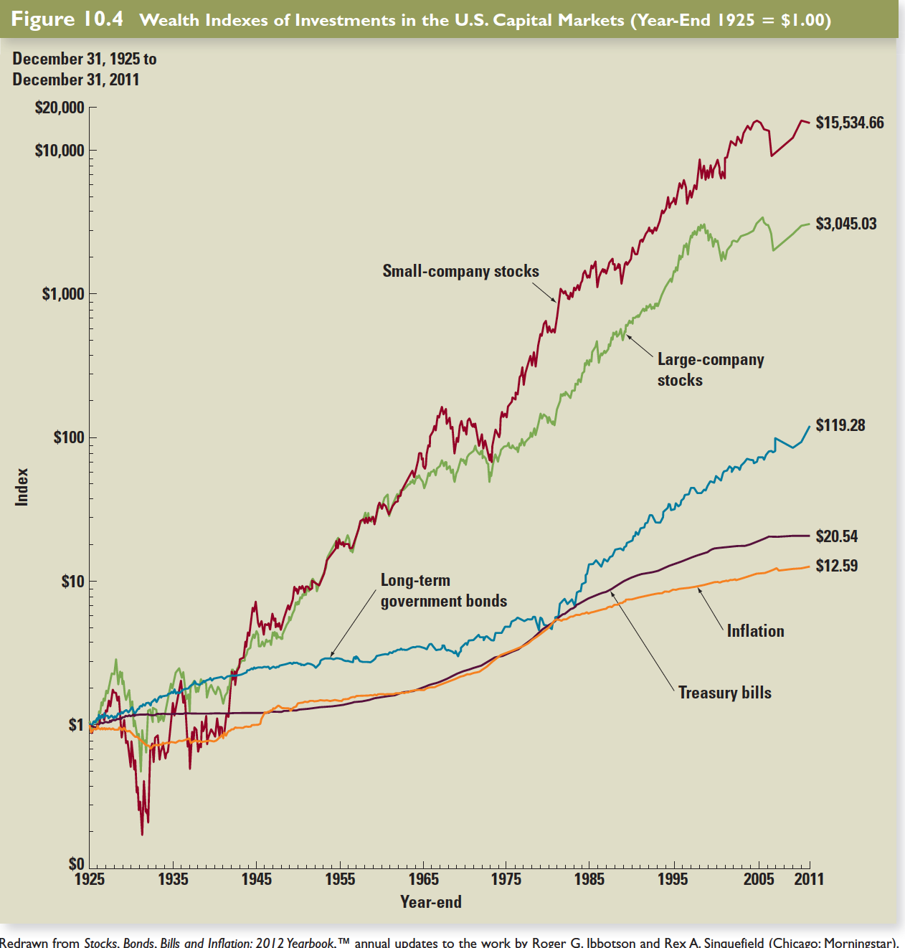

Slide 11
Inflation
real interest: r
Nominal interest: R
Inflation rate: f
Fisher Formula: 1+r = (1+R)/(1+f)
1+r = 1.1/1.02 = 1.078
Approximation for real return:
1+r+f+rf = 1+R
r = R-f

Slide 12
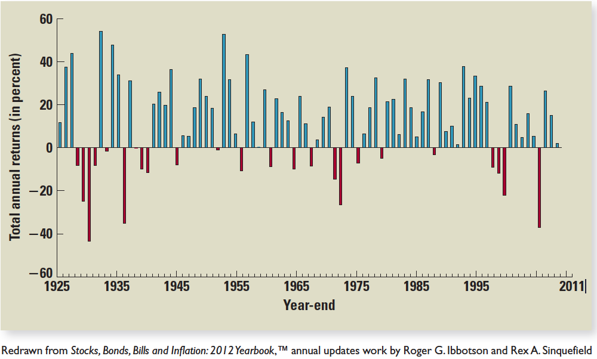
LARGE –COMPANY COMMON STOCKS

Slide 13
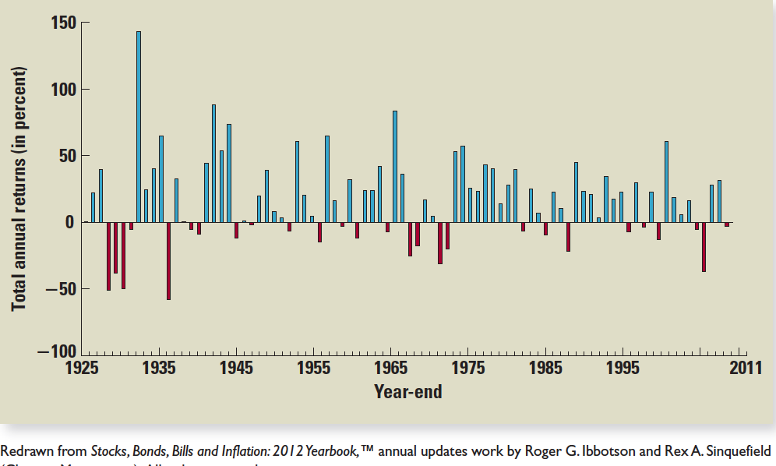
SMALL-COMPANY COMMON STOCKS

Slide 14
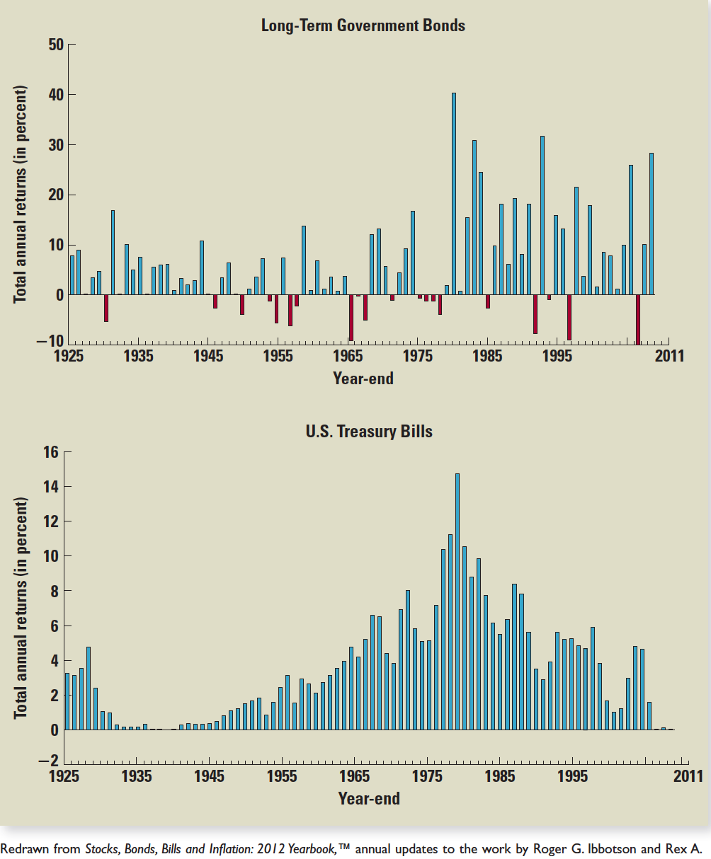

Slide 15


10.3 Return Statistics
The history of capital market returns can be summarized by describing the:
average return
the standard deviation of those returns
the frequency distribution of the returns

Slide 16
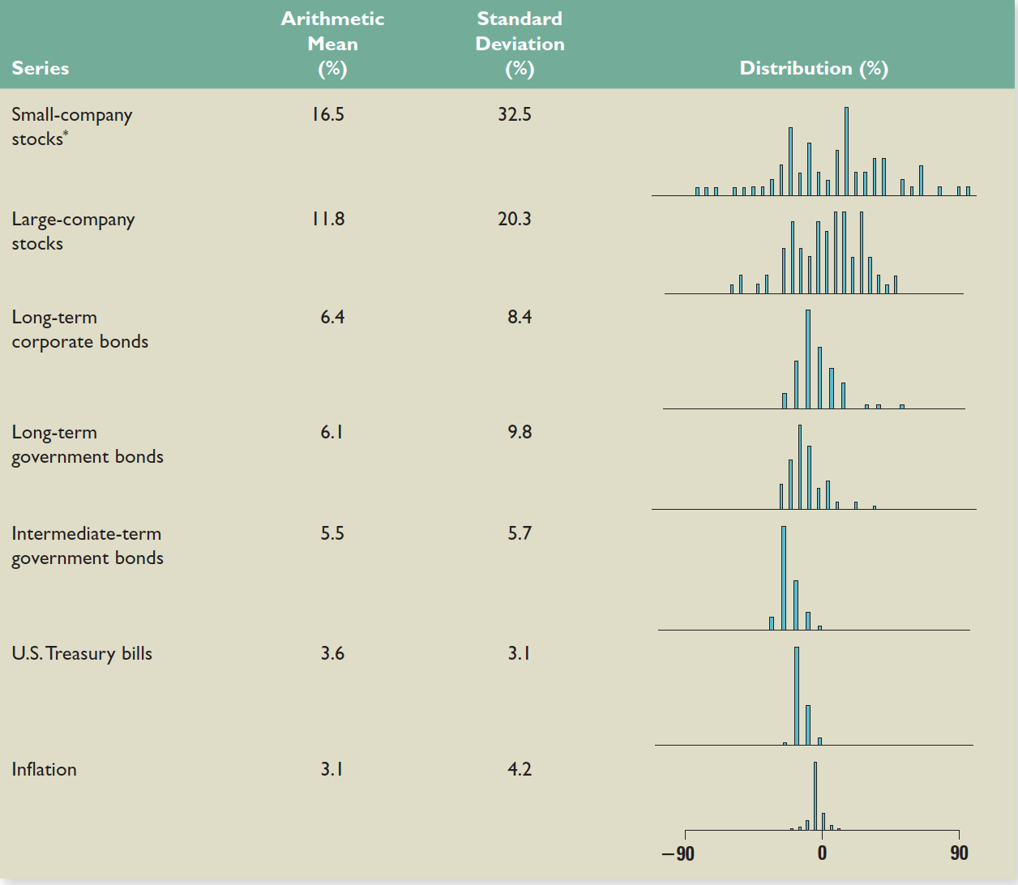

Slide 17
10.4 Average Stock Returns and Risk-Free Returns
The Risk Premium is the added return (over and above the risk-free rate) resulting from bearing risk.
One of the most significant observations of stock market data is the long-run excess of stock return over the risk-free return.
The average excess return from large company common stocks for the period 1926 through 2011 was:
8.2% = 11.8% – 3.6%
The average excess return from small company common stocks for the period 1926 through 2011 was:
12.9% = 16.5% – 3.6%
The average excess return from long-term corporate bonds for the period 1926 through 2011 was:
2.5% = 6.1% – 3.6%

Slide 18
Risk Premiums
Suppose that The Wall Street Journal announced that the current rate for one-year Treasury bills is 2%.
What is the expected return on the market of small-company stocks?
Recall that the average excess return on small company common stocks for the period 1926 through 2011 was 12.9%.
Given a risk-free rate of 2%, we have an expected return on the market of small-company stocks of 14.9% = 12.9% + 2%

Slide 19
The Risk-Return Tradeoff
Small-Company Stocks
Large-Company Stocks
T-Bonds
T-Bills

Slide 20
10.5 Risk Statistics
There is no universally agreed-upon definition of risk.
The measures of risk that we discuss are variance and standard deviation.
The standard deviation is the standard statistical measure of the spread of a sample, and it will be the measure we use most of this time.
Its interpretation is facilitated by a discussion of the normal distribution.

Slide 21
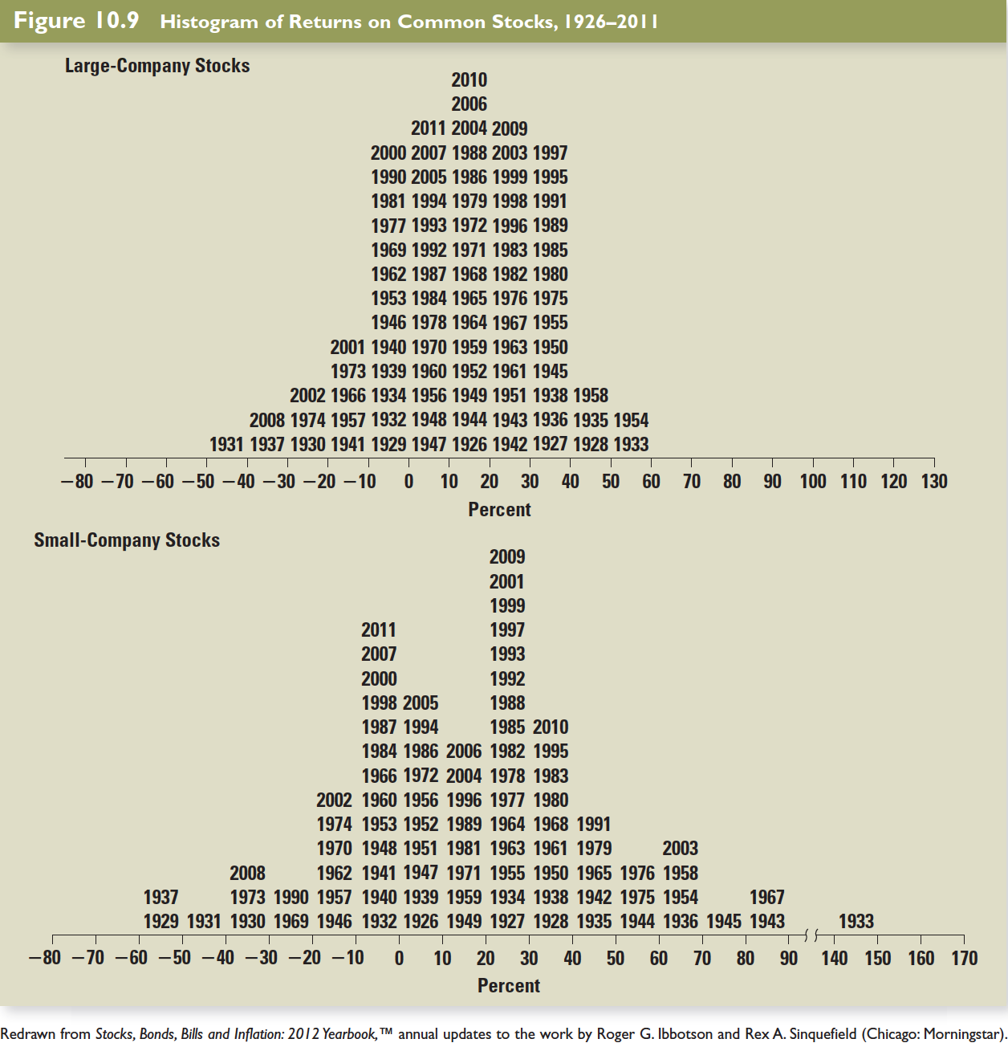

Slide 22
Normal Distribution
A large enough sample drawn from a normal distribution looks like a bell-shaped curve.
Probability
The probability that a yearly return will fall within 20.0 percent of the mean of 12.3 percent will be approximately 2/3.
– 3σ – 47.7%
– 2σ – 27.7%
– 1σ – 7.7%
0 12.3%
+ 1σ 32.3%
+ 2σ 52.3%
+ 3σ 72.3%
Return on large company common stocks
68.26%
95.44%
99.74%

Slide 23
Normal Distribution
The 20.0% standard deviation we found for large stock returns from 1926 through 2011 can now be interpreted in the following way:
If stock returns are approximately normally distributed, the probability that a yearly return will fall within 20.0 percent of the mean of 12.3% will be approximately 2/3.

Slide 25
Example – Return and Variance
Year | Actual Return | Average Return | Deviation from the Mean | Squared Deviation
1 | .15 | .105 | .045 | .002025
2 | .09 | .105 | -.015 | .000225
3 | .06 | .105 | -.045 | .002025
4 | .12 | .105 | .015 | .000225
Totals |  |  | .00 | .0045
Variance = .0045 / (4-1) = .0015 Standard Deviation = .03873
Notes:
Remind students that the variance for a sample is computed by dividing by the number of observations – 1.
The standard deviation is just the square root of the variance. I also find it beneficial to explain how to calculate deviations of a sample on the financial calculator.

Slide 26
10.6 More on Average Returns
Arithmetic average – return earned in an average period over multiple periods
Geometric average – average compound return per period over multiple periods
The geometric average will be less than the arithmetic average unless all the returns are equal.
Notes:
The geometric average is very useful in describing the actual historical investment experience.

Slide 27
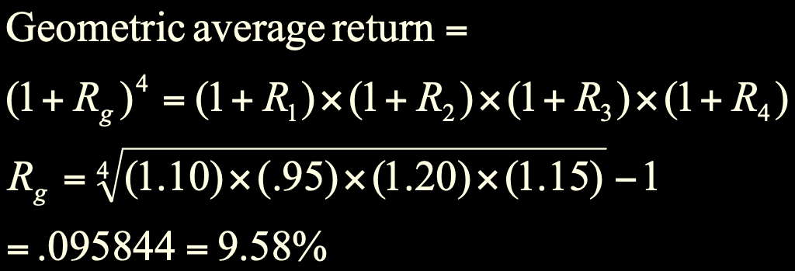
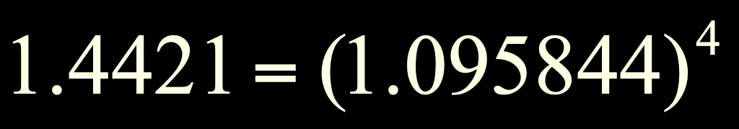
Geometric Return: Example
Recall our earlier example:
So, our investor made an average of 9.58% per year, realizing a holding period return of 44.21%.

Slide 28
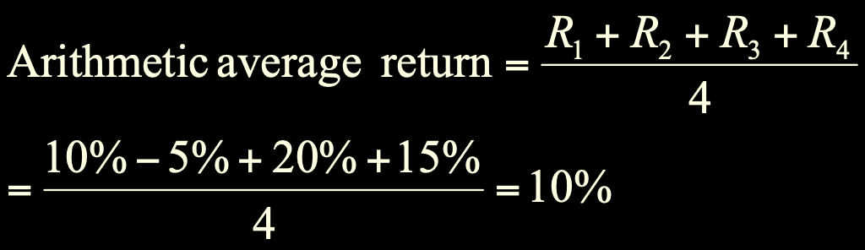
Geometric Return: Example
Note that the geometric average is not the same as the arithmetic average:

Slide 29
Perspectives on the Equity Risk Premium
Over 1926-2007, the U.S. equity risk premium has been quite large:
Earlier years (beginning in 1802) provide a smaller estimate at 5.4%
Comparable data for 1900 to 2005 put the international equity risk premium at an average of 7.1%, versus 7.4% in the U.S.
Going forward, an estimate of 7% seems reasonable, although somewhat higher or lower numbers could also be considered rational

Slide 30
